Slide 1


Smile Sync: Streamlining Dental Hospital Database Management
Janaki Ramya Namburu

Slide 2
Introduction
Table
of
Contents
E-R diagram
Designing Database
Data Cleaning
Data Analysis
Conclusion

Slide 3

INTRODUCTION

Slide 4
Database
Blueprint for Structuring and Organizing Data.
DBMS
Software for creating and managing databases
Dental Clinic DBMS Crucial role in organizing patient data

Slide 5
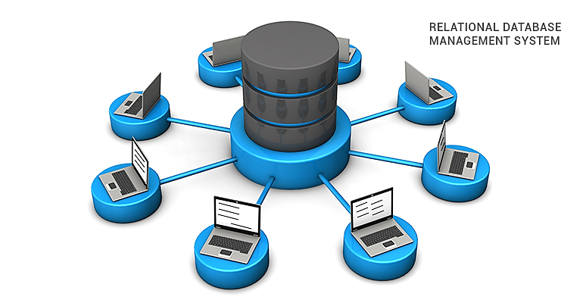
E-R DIAGRAM

Slide 6
Master Tables:
Patient info
Department info
Child Tables:
Insurance info
Consultation info
Treatment Costs
Diagnosis info
Treatment info
Doctor info
Billing info

Slide 7
Contact no.
Company
Insurance ID
Type
Consultation ID
Chief complaint
Address
Date
Medical history
Gender
Patient Demographics
1:1
1:1
Insurance
Consultation
Age
Insurance ID
1:M
Name
Diagnosis ID
Patient ID
Patient ID
Plan
Investigation
Consultation fees
Final Diagnosis
Specialization
Name
Consultation ID
HOD
Diagnosis
1:M
Name
Department info
1:M
Doctor info
Doctor ID
1:1
Dept ID
Treatment
Doctor ID
Dept ID
Treatment ID
CDT code
Billing ID
Treatment ID
cost
1:M
1:1
Treatment costs
Treatment
Billing
TC ID
Prescription
Diagnosis ID
TC ID

Slide 8
Designing Database Schema
Creating Structure and Relations
Required Structural Alterations
Loading Data

Slide 9
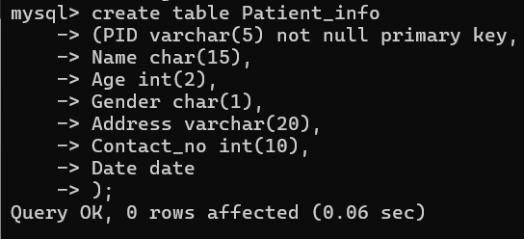
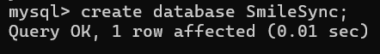
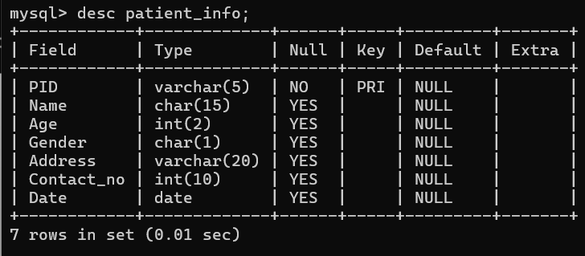
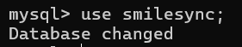
Creating Structure and Relations
Creating Table- Patient_info
Database- Smile sync
Structure of Patient_info

Slide 10
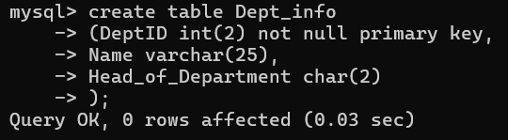
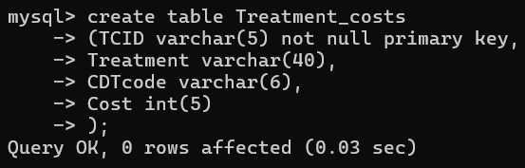
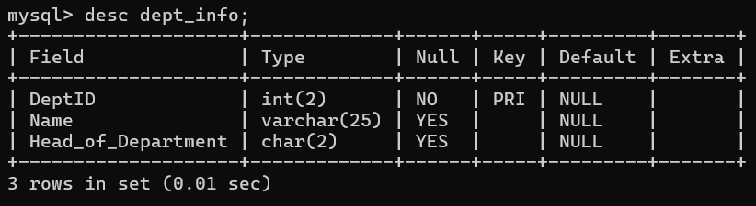
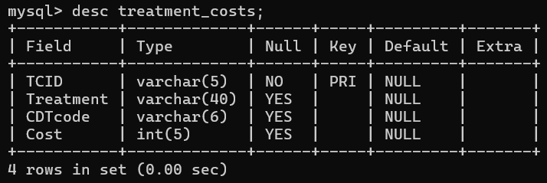
Creating Table- Dept_info
Creating Table- Treatment_costs
Structure of Dept_info
Structure of Treatment_costs

Slide 11
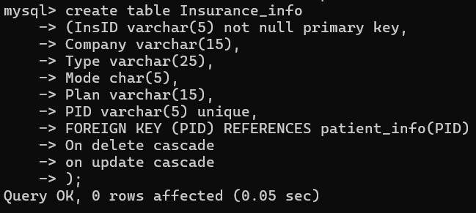
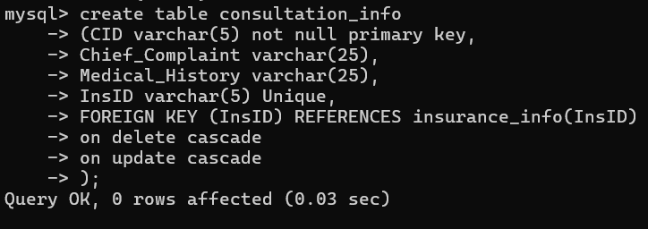
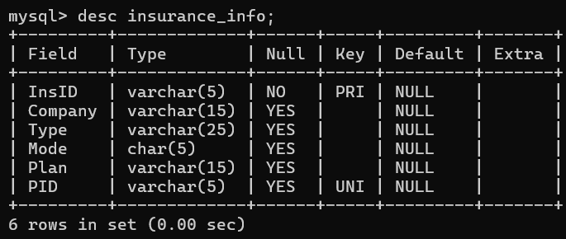
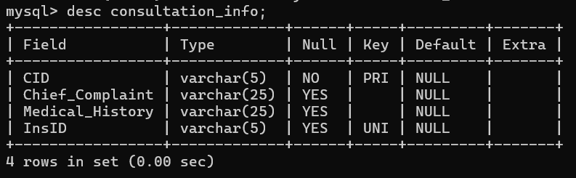
Creating Table- Insurance_info
Creating Table- Consultation_info
Structure of Insurance_info
Structure of Consultation_info

Slide 12
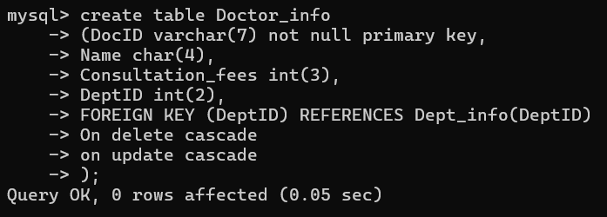
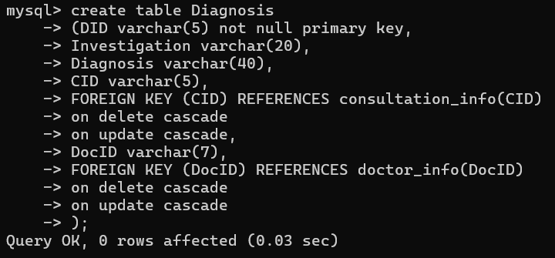
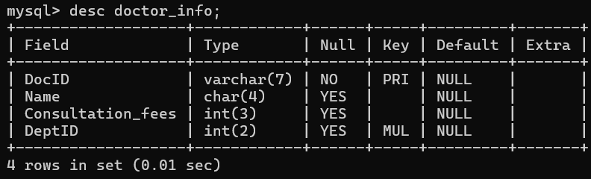
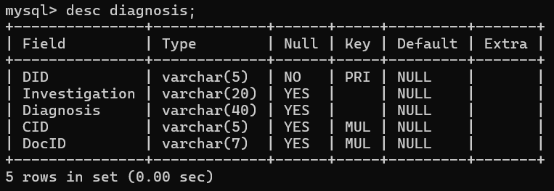
Creating Table- Doctor_info
Creating Table- Diagnosis
Structure of Doctor_info
Structure of Diagnosis

Slide 13
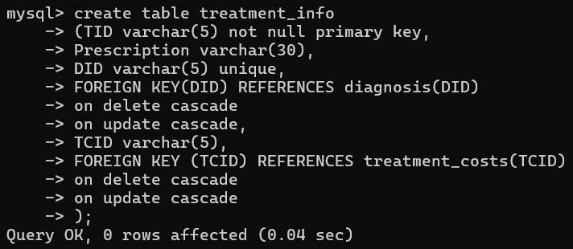
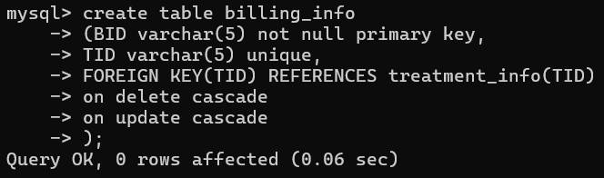
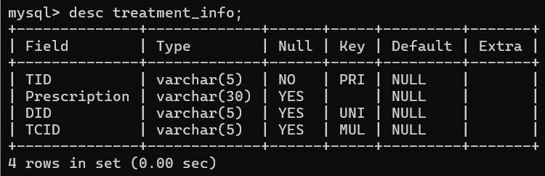
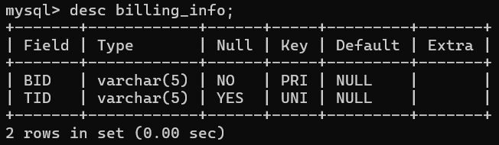
Creating Table- Treatment_info
Creating Table- Billing_info
Structure of Treatment_info
Structure of Billing_info

Slide 14
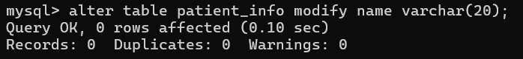
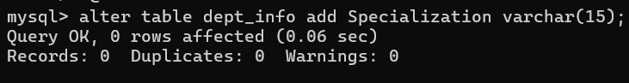
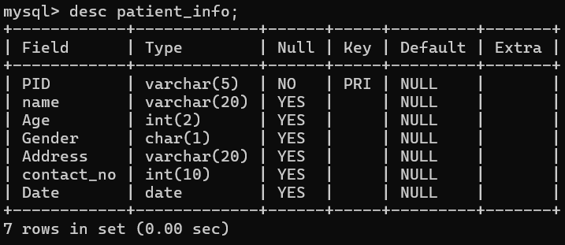
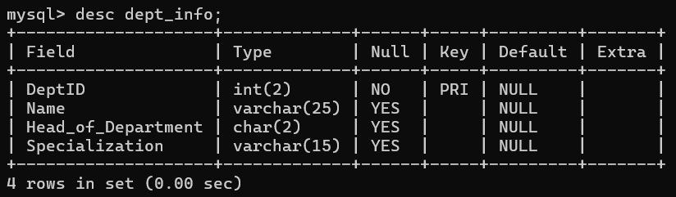
Structural Alterations
Modifying the datatype of ‘Name’ to varchar(20)
Adding new column ‘Specialization’ to dept_info table
Structure of Patient_info
Structure of Dept_info

Slide 15
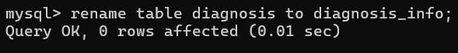
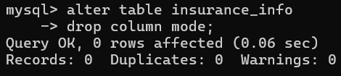
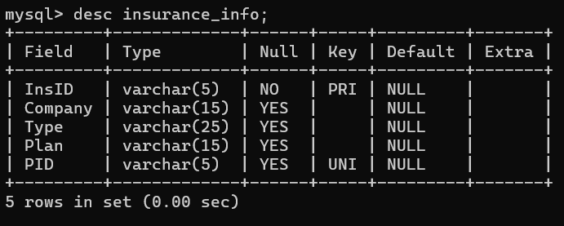
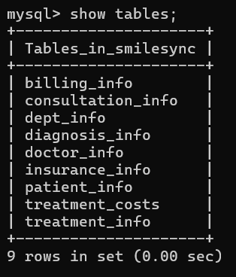
Removing the MODE column from insurance_info
Renaming diagnosis to diagnosis_info
Tables in Smile sync
Structure of Insurance_info

Slide 16
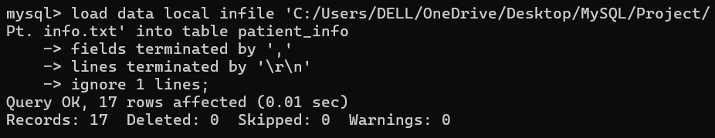
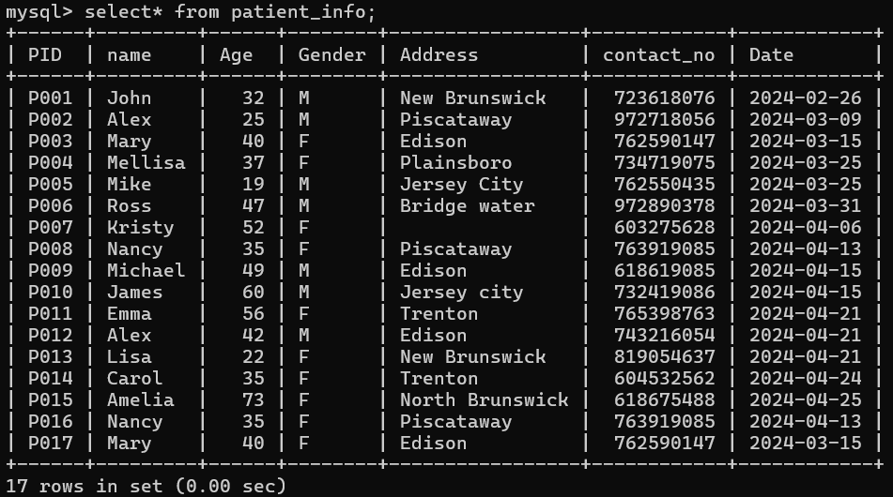
Loading Data
Patient_info

Slide 17
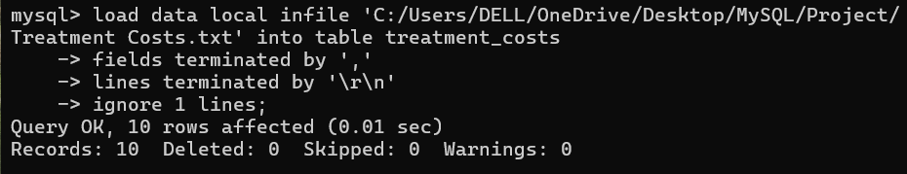
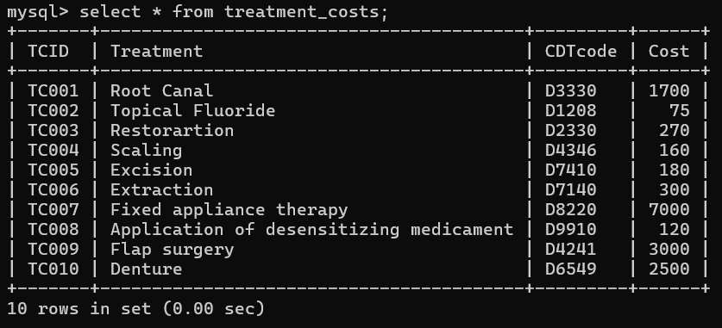
Treatment_costs

Slide 18
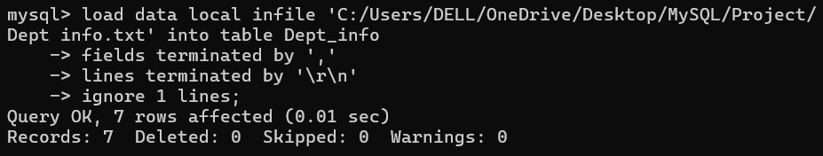
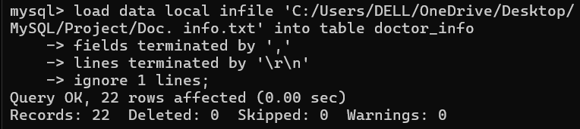
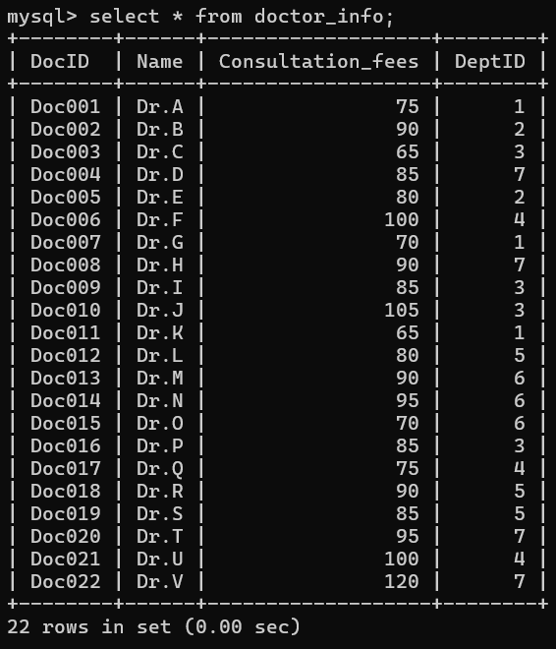
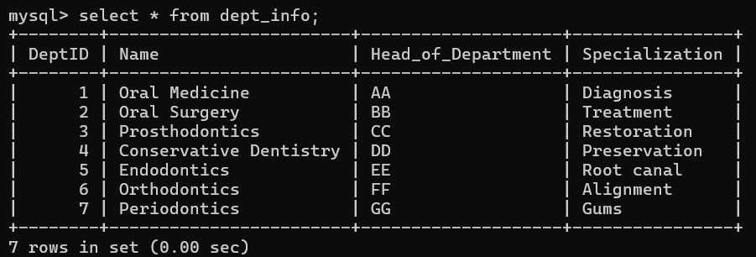
Dept_info
Doctor_info

Slide 19
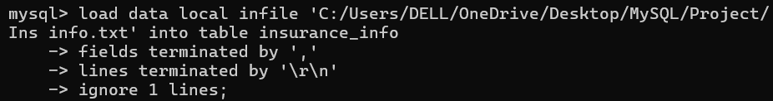
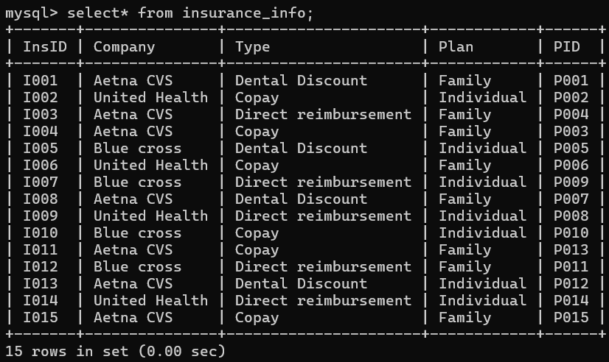
Insurance_info

Slide 20
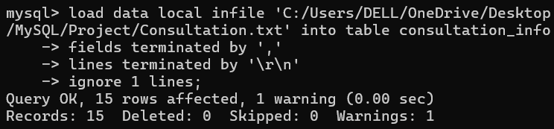
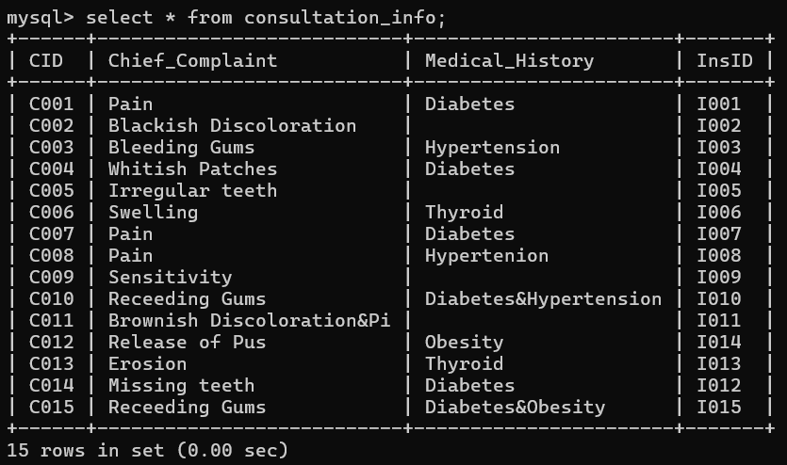
Consultation_info

Slide 21
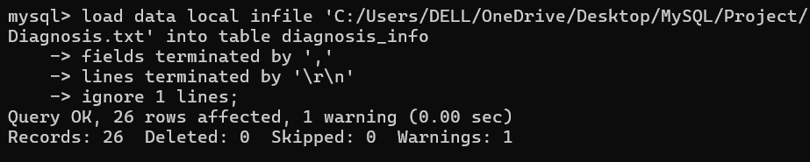
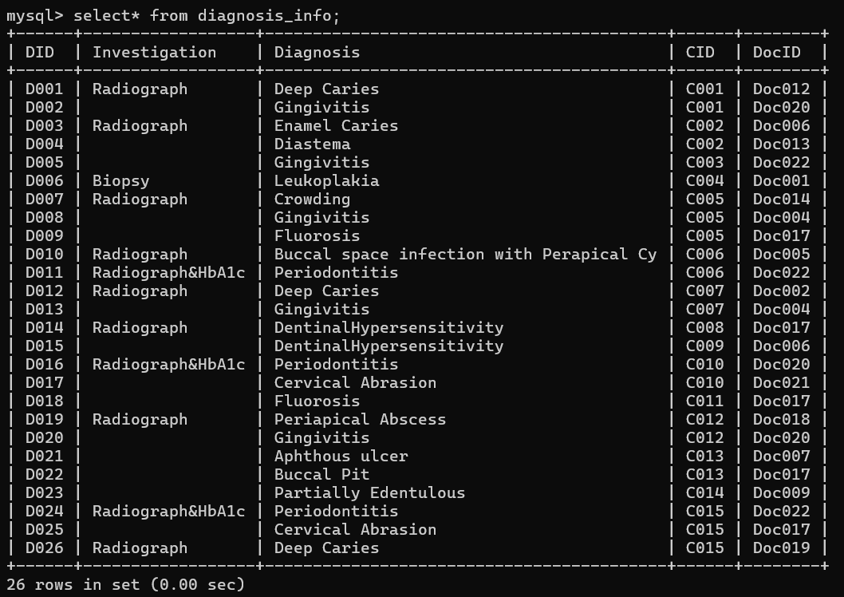
Diagnosis_info

Slide 22
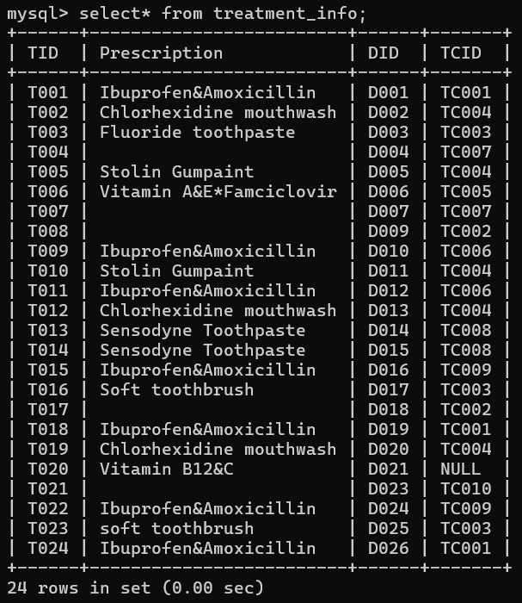
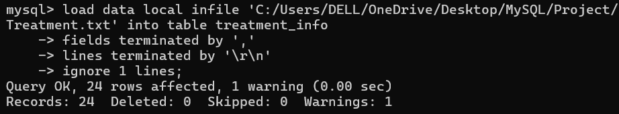
Treatment_info

Slide 23
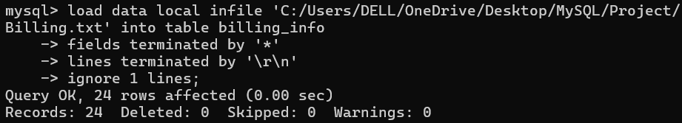
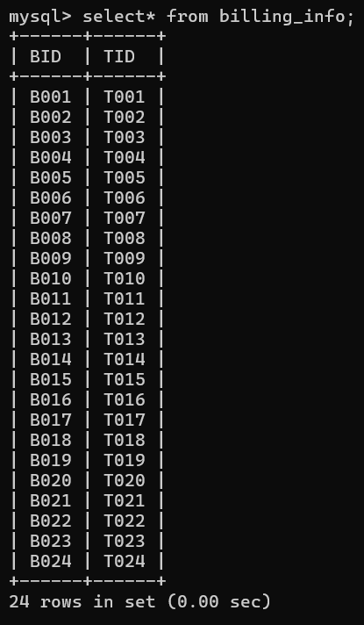
Billing_info

Slide 24
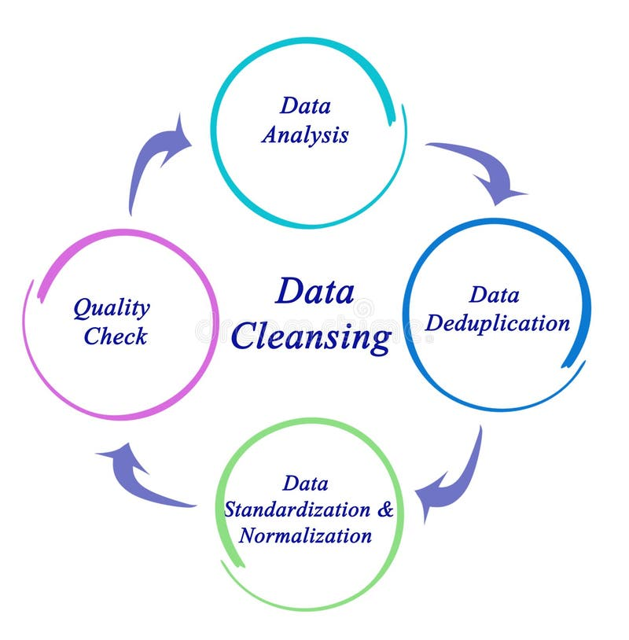
Data cleaning

Slide 25
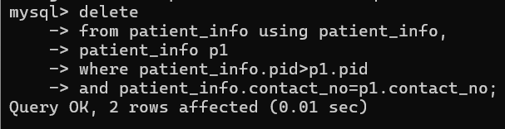
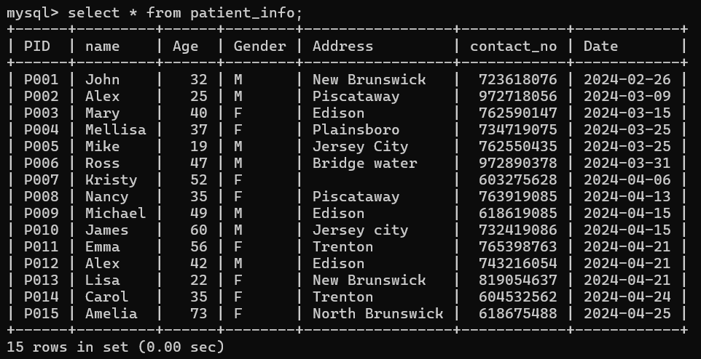


Removing duplicates
Function: DELETE
Removed 2 duplicates from patient_info

Slide 26




Dealing with Nulls
Function: NULLIF, TRIM
Filled empty spaces with NULL

Slide 27



Slide 28


Remove columns
Function: Alter-Drop column
Removed the unnecessary column ‘HOD’

Slide 29



Standardizing Data

Slide 30

Exploratory Data Analysis

Slide 31
OBJECTIVES
What are the cities from which patients have visited this clinic?
How many patients in the old age category visited the clinic?
How many Males and Females visited the clinic?
What was the flow of patients during the month of April?
Which insurance companies were chosen by patients residing in each area?
How does the demographic profile of patients vary across different insurance companies?
What are the most frequently reported chief complaints among patients?
What are the diagnoses made for each patient, along with the corresponding treatments performed?

Slide 32
Who is the doctor with the Third-highest number of diagnosed cases in the 'Periodontics' department?
Who are the Doctors not involved in any cases?
Identify the patients whose name begins with any character followed by 'a' and ends with 'y', and who have been diagnosed with 'Leukoplakia’?
What is the monthly distribution of treatments performed, ranked by the number of treatments in descending order?
What is the total Revenue generated by hospital?
What is the amount that should be paid by the insurance companies?
Which patients got the maximum and minimum bills?

Slide 33



Cities from which patients
have visited this clinic
Number of old age Patients who visited the clinic
Number of Males and Females who visited the clinic
Function: DISTINCT
Patients have visited from 8 different cities
Function: COUNT
Total of 8 females and 7 males visited the clinic,
In that 6 patients are in old age

Slide 34




Insurance companies chosen by patients residing in each area
Flow of patients during the month of April
Function: COUNT, GROUP BY
Retrieved number of patients visited the clinic based on specific city
Function: COUNT, GROUP, ORDER
Retrieved number of patients having insurance plans from which company based on area of residence

Slide 35




Demographic profile of patients across different insurance companies
2 Most frequently reported chief complaints among patients
Function: ROUND, AVG, GROUP
Mean age, gender of patients with respect to the insurance companies
Function: GROUP, ORDER,LIMIT
Created an inner join to the check top most chief complaints by patients

Slide 36


Diagnoses made for each patient, along with the corresponding treatments performed
Function: CONCAT_WS
Concatenated the Diagnosis and treatment column with separator ‘-’

Slide 37




The doctor with the Third-highest number of diagnosed cases in the 'Periodontics' department
Doctors not involved in any cases
Function: LIMIT, OFFSET
DR.D is the doctor with 3rd highest number of cases
Function: GROUP BY, HAVING
6 doctors who are not involved with any case

Slide 38




The patient whose name begins with any character followed by 'a' and ends with 'y', and who have been diagnosed with 'Leukoplakia'
The monthly distribution of treatments performed
Function: LIKE
MARY is the patient with Leukoplakia
Function: SUBSTRING
14 treatments were done in April,8 in march and 2 in february

Slide 39




Indexing

Slide 40




Testing the delete cascade function
Master table – Dept_info
ON DELETE CASCADE
ON UPDATE CASCADE
Child table – Doctor_info
Child table- Diagnosis_info

Slide 41


4 Doctors were deleted because of removing Department no. 7

Slide 42



8 rows were removed from diagnosis table

Slide 43

Revenue generated by the hospital

Slide 44


Function: COALESCE
Created table – Revenue
Created columns- Consultation, Treatment_cost and total bill

Slide 45


Conditional Processing

Slide 46


Total Revenue

Slide 47




Drop tables- Bill and revenue
Amount to be paid by the insurance companies
Function: UCASE, ROUND
Insurance companies are grouped and ordered based on the amount to be paid
Function: DROP table

Slide 48



Maximum and Minimum bills by patients
Total revenue
Function: MAX, MIN

Slide 49

Bill for the patient who have undergone maximum number of patients

Slide 50


VIEW

Slide 51


Which month has created Highest revenue?
Function: MONTH, LIMIT
March is having the highest revenue

Slide 52

CONCLUSION

Slide 53
smile sync aimed to streamline the management of dental hospital operations through efficient data organization and retrieval.
By structuring patient information, insurance details, consultations, diagnoses, treatments, and costs within a relational database, it enhances the hospital's ability to track patient care, manage resources, and optimize billing processes.
We can see the visit of 15 patients from February to April generating a total revenue of 32,550, with highest in March.
There are 7 departments with 22 doctors dealing with patients.
There are 3 insurance companies with 3 different types of dental insurance plans.

Slide 54


Slide 55


